Slide 1




Slide 2

TEST TIME ON TIME AND SPACE COMPLEXITY
URL:https://forms.gle/YDWLEoCL7apATTAU8
QR CODE:

Slide 3

SIMPLE SIEVE

Slide 4


TOPICS
Introduction
Example
Algorithm
Pseudocode
Program
Interview Questions

Slide 5
Simple Sieve
The Sieve of Eratosthenes is the simplest prime number sieve.
It is a Prime number algorithm to search all the prime numbers in a given limit.
There are several prime number sieves. For example- the Sieve of Eratosthenes, Sieve of Atkin, Sieve of Sundaram, etc.
This algorithm filters out the prime number in an iterative approach.
The filtering process starts with the smallest prime number. A Prime is a natural number that is greater than 1 and has only two divisors, viz., 1 and the number itself. The numbers that are not primes are called composite numbers.
In the sieve of the Eratosthenes method, a small prime number is selected first, and all the multiples of it get filtered out. The process runs on a loop in a given range.

Slide 6
PSEUDOCODE
find primes up to N
For all numbers a: from 2 to sqrt(n)
IF a is unmarked THEN
a is prime
For all multiples of an (a < n)
mark multiples of as a composite
All unmarked numbers are prime!

Slide 7
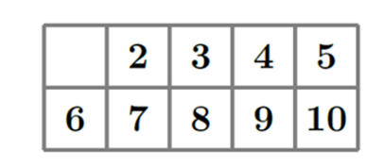
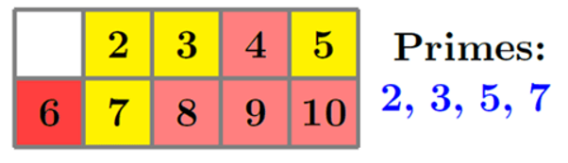
EXAMPLE
Let’s take the number range from 2 to 10.
After applying the Sieve of Eratosthenes, it will produce the list of prime numbers 2, 3, 5, 7

Slide 8
ALGORITHM
Step 1) Create a list of numbers from 2 to the given range n. We start with 2 as it is the smallest and first prime number.
Step 2) Select the smallest number on the list, x (initially x equals 2), traverse through the list, and filter the corresponding composite numbers by marking all the multiples of the selected numbers.
Step 3) Then choose the next prime or the smallest unmarked number on the list and repeat step

Slide 9
ALGORITHM
Step 4) Repeat the previous step until the value of x should be lesser than or equal to the square root of n (x<= )
Step 5) After those four steps, the remaining unmarked numbers would be all the primes on that given range n.

Slide 10
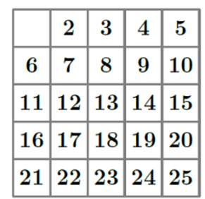
Representation
EXAMPLE
Find the list of prime numbers from 2 to 25. So, n=25.
Step 1) In the first step, we will take a list of numbers from 2 to 25 as we selected n=25.
Numbers from 2 to 25

Slide 11
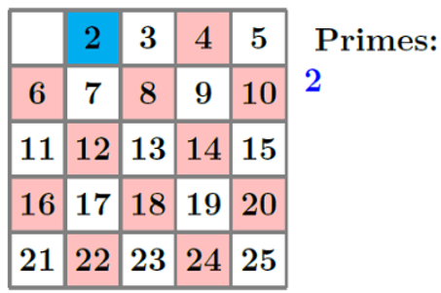
EXAMPLE
Step 2) Then we select the smallest number on the list, x. Initially x=2 as it is the smallest prime number. Then we traverse through the list and mark the multiples of 2.
The multiples of 2 for the given value of n is: 4, 6, 8, 10, 12, 14, 16, 18, 20, 22, 24.
Eliminated multiples of 2
Note: Blue colour denotes the selected number, and pink colour denotes the eliminated multiples

Slide 12
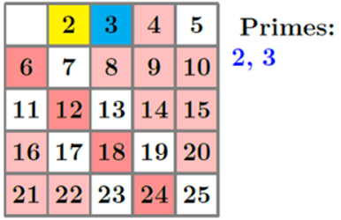
Representation
EXAMPLE
Step 3) Then we choose the next smallest unmarked number, which is 3, and repeat the last step by marking the multiples of 3.
Eliminated multiples of 3

Slide 13
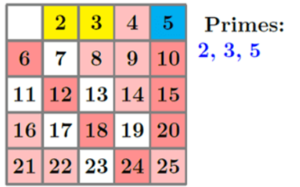
Representation
EXAMPLE
Step 4) We repeat step 3 in the same way until x= or 5
Eliminated multiples of 5

Slide 14
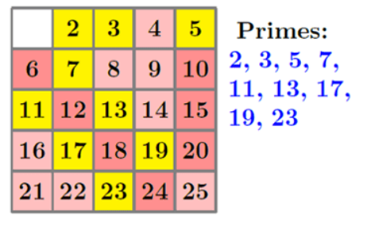
EXAMPLE
Step 5) The remaining non-marked numbers would be the prime numbers from 2 to 25.
Remaining are primes

Slide 15
COMPLEXITY
The time and space complexity of The Sieve of Eratosthenes algorithm is as follows:
• time complexity: Θ(N log log N)
• Space complexity: Θ(N)

Slide 16
FIND ALL THE PRIME NUMBERS
import java.util.*; public class Main{ public static void main(String args[]) { Scanner sc = new Scanner(System.in); System.out.println("Enter a number"); int num = sc.nextInt(); boolean[] bool = new boolean[num]; for (int i = 0; i< bool.length; i++) { bool[i] = true; } for (int i = 2; i< Math.sqrt(num);i++){ if(bool[i] == true) { for(int j = (i*i); j<num; j = j+i) { bool[j] = false; } }} | System.out.println("List of prime numbers upto given number are : "); for (int i = 2; i< bool.length; i++) { if(bool[i]==true) { System.out.println(i); } } } }

Slide 17
INTERVIEW QUESTIONS

Slide 18
Interview questions
1. What is the Sieve of Eratosthenes?
The Sieve of Eratosthenes is an ancient algorithm used to find all prime numbers up to a given limit. It works by iteratively marking the multiples of each prime number starting from 2.

Slide 19
Interview questions
Interview questions
2. Explain the basic idea behind the Sieve of Eratosthenes algorithm.
The algorithm starts with a list of numbers from 2 to the given limit. It begins by marking the first number (2) as prime and then crosses out all multiples of 2. It then moves to the next unmarked number (3), marks it as prime, and crosses out its multiples. This process continues until all numbers have been considered.

Slide 20
Interview questions
Interview questions
3. What is the time complexity of the Sieve of Eratosthenes algorithm?
The time complexity of the Sieve of Eratosthenes is O(n log log n), where n is the given limit.

Slide 21
Interview questions
Interview questions
4. Can the Sieve of Eratosthenes be used to find prime numbers in a given range, rather than up to a limit? If so, how?
Yes, the Sieve of Eratosthenes can be modified to find prime numbers within a given range [L, R]. To achieve this, you can create a boolean array representing numbers from L to R, and then apply the sieve algorithm on this array while considering the multiples of primes starting from 2.

Slide 22
Interview questions
Interview questions
The space complexity of the Sieve of Eratosthenes is O(n), where n is the given limit. This is because it requires a boolean array of size n+1 to keep track of prime and non-prime numbers.
5. What is the space complexity of the Sieve of Eratosthenes algorithm?

Slide 23
Practice questions
Question 1: Count the Number of Primes Up to a Given Number
How would you count the number of prime numbers up to a given integer \( n \) using the Sieve of Eratosthenes?
Sample Input:
Enter a number: 20
Sample Output:
Number of prime numbers up to 20 is: 8

Slide 24
Practice questions
Practice questions
Question 2: Sum of All Primes Up to a Given Number
How would you calculate the sum of all prime numbers up to a given integer \( n \) using the Sieve of Eratosthenes?
Sample Input:
Enter a number: 20
Sample Output:
Sum of all prime numbers up to 20 is: 77

Slide 25
Practice questions
Practice questions
Question 3: Find the k-th Prime Number
How would you find the k-th prime number using the Sieve of Eratosthenes? Assume the program prompts the user for \( n \) (the range) and \( k \) (the position).
Sample Input:
Enter the range: 50
Enter the position (k): 10
Sample Output:
The 10th prime number up to 50 is: 29

Slide 26
Practice questions
Practice questions
Question 4: List of Twin Primes
How would you list all twin primes up to a given integer \( n \) using the Sieve of Eratosthenes? Twin primes are pairs of prime numbers that differ by 2.
Sample Input:
Enter a number: 50
Sample Output:
List of twin primes up to 50 are:
(3, 5)
(5, 7)
(11, 13)
(17, 19)
(29, 31)
(41, 43)

Slide 27




THANK YOU
+91 78150 95095
codemithra@ethnus.com
www.codemithra.com

Slide 28









/ethnuscodemithra
Ethnus Codemithra
/ethnus
/code_mithra
https://learn.codemithra.com
codemithra@ethnus.com
+91 7815 095 095
+91 9019 921 340

